Slide 1

CS3503 – Java Programming PBL
Project Review
OCR KITCHEN INVENTORY AND EXPIRY TRACKING
Presentation by
Sagar Arun (210425205150)
Disvan S (210425205038)
Information Technology
Mentor
Dr. D. Lita Pansy
Assistant Professor
Information Technology

Slide 2
Abstract
Project Concept: "Shelf Life" — an OCR-based kitchen inventory management and expiry monitoring application.
Core Problem: Mitigating household food wastage caused by forgotten or unmonitored grocery stock.
Methodology: Merges Java Swing for UI, Tess4J (Tesseract OCR) for text extraction from labels/receipts, and an automated email alert system for proactive notifications.

Slide 3
Introduction
Background: Inefficient pantry tracking directly translates to financial losses and organic waste.
The Manual Overhead: Keeping tabs on variables like custom categories, dynamic expiry dates, and varying metrics by hand is unsustainable.
Project Mandate: Deliver a localized, zero-overhead desktop control environment for daily household tracking.

Slide 4
Literature Survey
Packaged Expiry Recognition [1]: Evaluated open-source OCR text pre-processing models under diverse lighting thresholds.
Tesseract Architectural Framework [2]: Focused adaptive rules for line isolation and localized font adjustments.
AI/Deep Learning Date Tracking [3]: Leveraged neural nets and Attention OCR mechanisms to parse regional image snapshots.
QR / alternative track indexes [4, 5]: Explored static identification tokens and matching recipe suggestion logic engines.

Slide 5
System Requirements
Software Environment:
  Language runtime: Java 21
  GUI Toolkit: Java Swing
  Parsing Engine: Tess4J / Tesseract OCR
  Mailer Integration: Jakarta Mail API
  Storage approach: Flat text serialization architecture (Pantry.txt)
Hardware Profile:
  AMD Ryzen 5 processor baseline (or equivalent core logic) paired alongside a minimum of 8 GB RAM.

Slide 6
Existing System
Current Alternatives:
  Manual logging, standalone visual labels, or generic spreadsheets.
Flaws:
  Extreme reliance on regular manual input.
  Total absence of pro-active notification mechanisms.
  No visual dashboard grouping items natively by safety thresholds.

Slide 7
Proposed Methodology & Proposed Diagram
Operational Stages:
  Capture/Input: Scans label pictures or receipt sheets.
  Analysis Block: Text undergoes parsing via Tess4J to extract item strings and date records.
  Categorization Pipeline: Stamped records undergo mathematical shelf-life evaluation against the current system date.
  Output Matrix: Refreshes internal array metrics and dispatches alerts when safe windows decay.

Slide 8
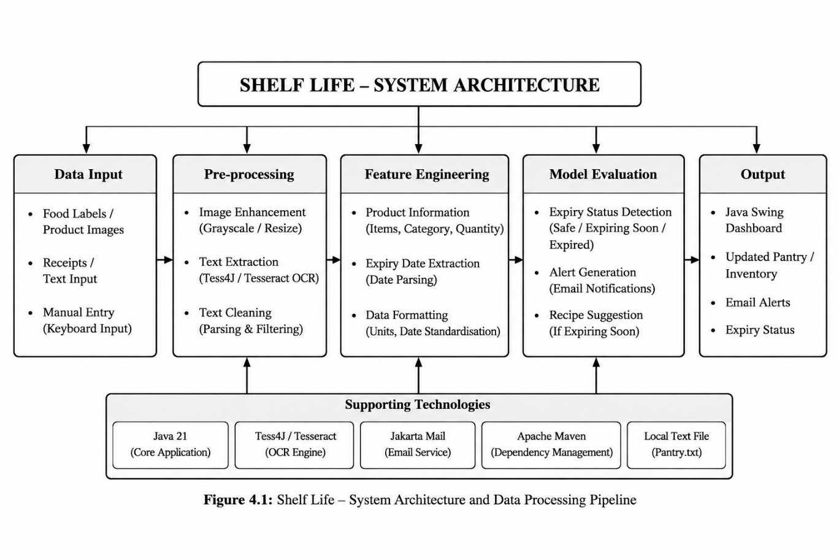
System Architecture

Slide 9
Modules
Authentication module: Local validation checking profile authority.
Inventory core service: CRUD mechanics managing pantry objects.
OCR engine module: Orchestrates text extraction and dynamic timestamp processing.
Status evaluator & mail routine: Calculates decay status, sorts buckets, and acts as the delivery client framework for alerts.
Swing layout engine: Powers custom component interaction widgets.

Slide 10
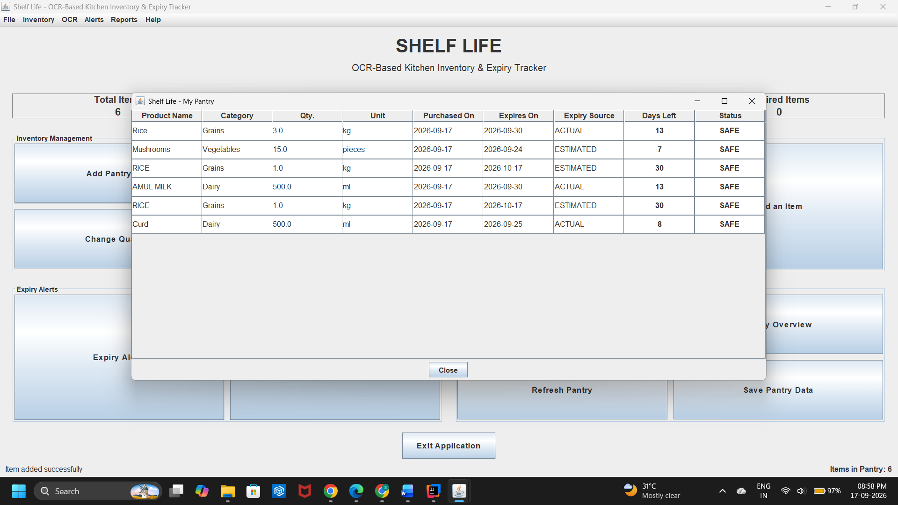
Result and Discussion – Pantry Forms & Data Views
Functional implementation demonstrates robust entry form operations.
Fields elegantly handle variable metrics (e.g., matching weights in grams, millilitres, litres).
Text handling loops handle dirty output strings from noisy OCR operations into regular calendar instances smoothly.

Slide 11
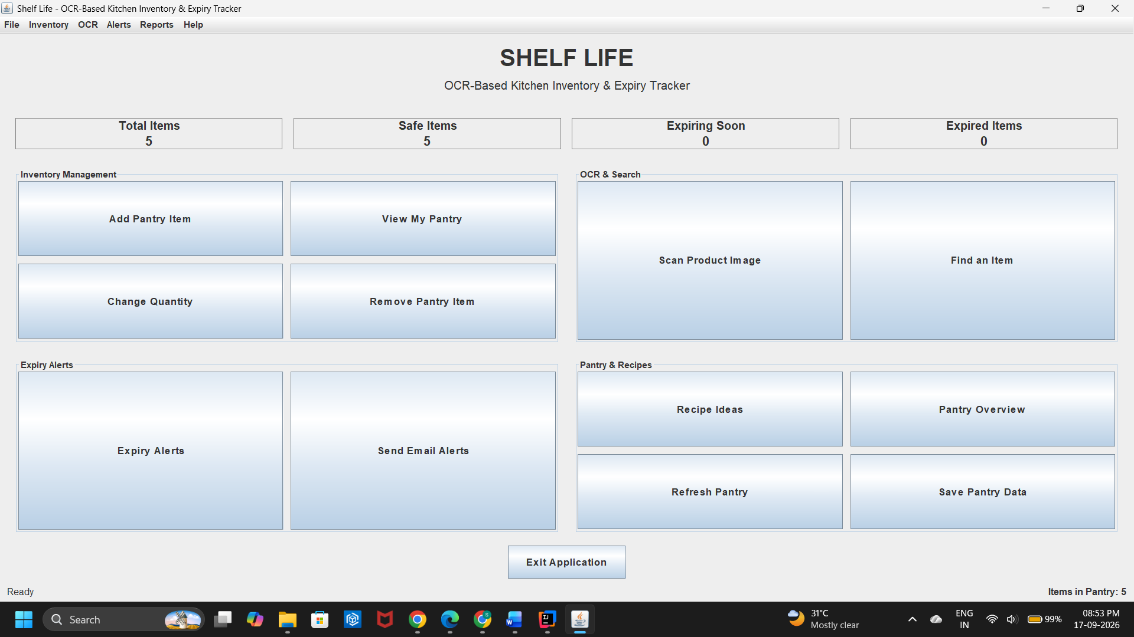
Result and Discussion – Dashboard Analytics
Visual Summary Counters: Dynamic metrics displaying total tracking load divided securely into color-coded indicators: Safe, Expiring Soon, and Expired.
Single-click interface hooks mapping out full summaries directly on the desktop grid layer.

Slide 12
Future Enhancement
Introduce support for native Barcode and QR code processing for immediate data scanning.
Build external supermarket pricing and grocery API check syncs to recommend automated cart purchases.
Scale logic routines to process perspective distortions or low-light blurry inputs via adaptive image-filtering models.

Slide 13
Conclusion
The application successfully accomplishes desktop kitchen asset tracking metrics within a local sandbox format.
The local flat-file methodology ensures zero database overhead or high deployment friction while safeguarding identity privacy.
Proved that combining simple object relationships with OCR libraries dramatically minimizes structural validation fatigue.

Slide 14
References
[1] K. Hosokawa et al., "Recognition of expiration dates written on food packages with open-source OCR," IJCTE, 2018.
[2] R. Smith, "An overview of the Tesseract OCR engine," ICDAR, 2007.
[3] J. Zhao & A. D. Campbell, "An intelligent system for tracking and managing household food inventory," University of Auckland, 2026.

Slide 15



Project Video Link
Add the Direct URL/Drive link of your project in voice over video
GitHub Repository Link
Add GitHub Repo link of your project
Sagar Arun, Disvan S
Information Technology

